Slide 1
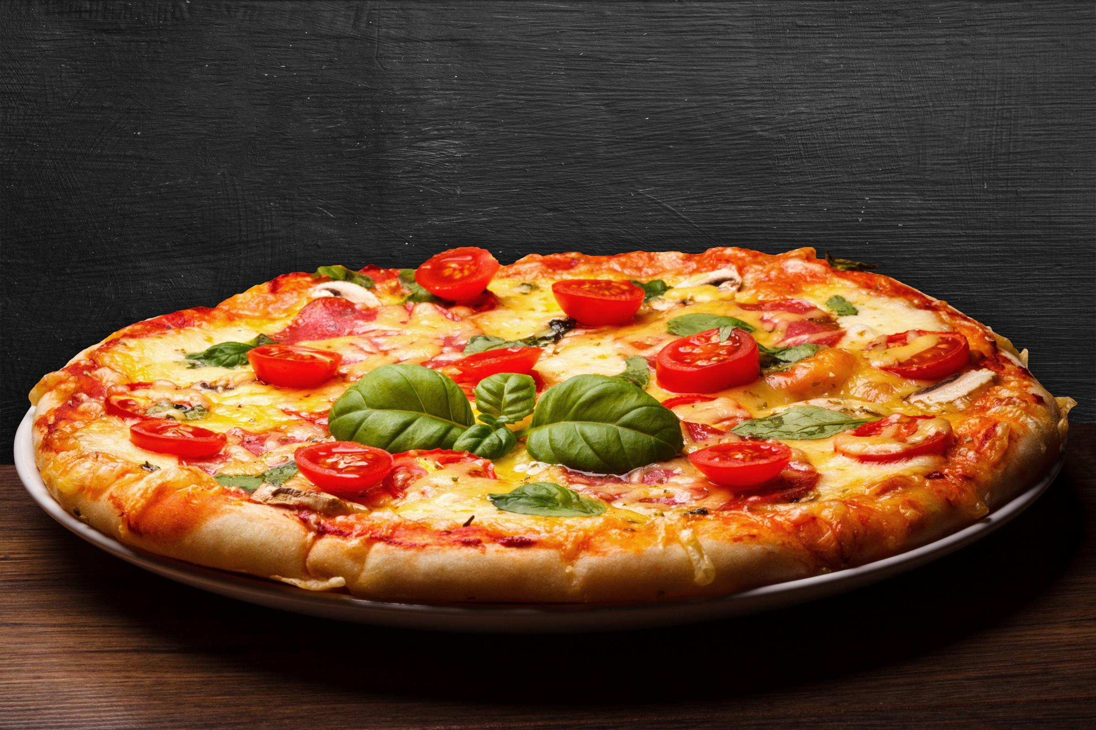
pizza sales analysis using sql

Slide 2



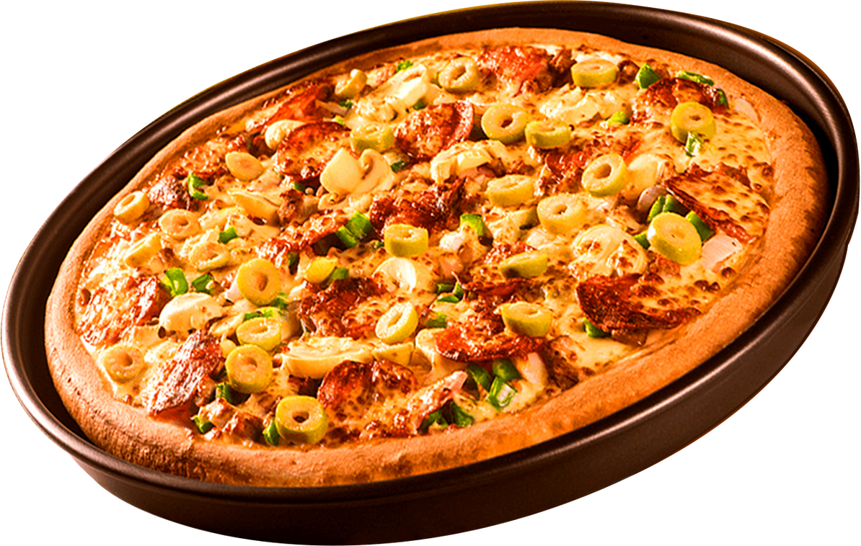

pizza analysis
hello everyone
my name is Siba Prasad Rana, and I completed a pizza sales analysis using SQL for this project ,I utilize SQL queries to explore data and gain insights that could enhance sales and operations. ThisMy name is Siba Prasad Rana, and I completed a pizza sales analysis for this project using SQL. I utilized SQL queries to explore the data and gain insights that could enhance sales and operations. This project demonstrates my SQL skills and my ability to work with data to support business decisions. project showcases my SQL skills and my ability to work with date to support business decisions.

Slide 3

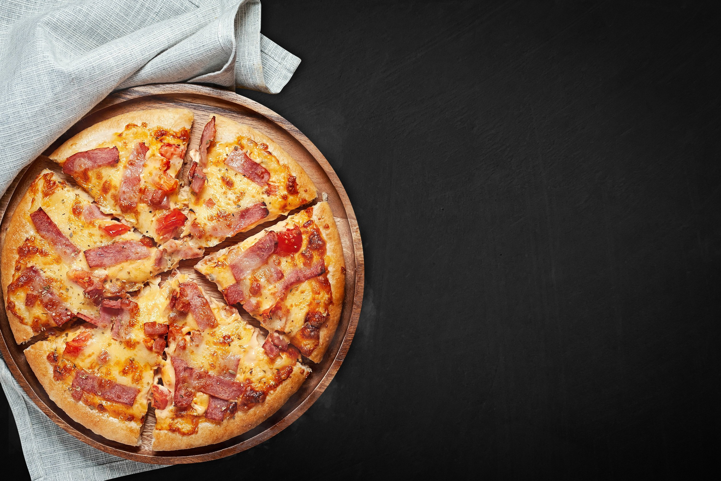
pizza analysis
questions
Basic:
Retrieve the total number of orders placed.
Calculate the total revenue generated from pizza sales.
Identify the highest-priced pizza.
Identify the most common pizza size ordered.
List the top 5 most ordered pizza types along with their quantities.
Intermediate:
Join the necessary tables to find the total quantity of each pizza category ordered.
Determine the distribution of orders by hour of the day.
Join relevant tables to find the category-wise distribution of pizzas.
Group the orders by date and calculate the average number of pizzas ordered per day.
Determine the top 3 most ordered pizza types based on revenue.
Advanced:
Calculate the percentage contribution of each pizza type to total revenue.
Analyze the cumulative revenue generated over time.
Determine the top 3 most ordered pizza types based on revenue for each pizza category.

Slide 4
pizza analysis
objective
- Analyze sales trend variations over time.
- Identify the most popular pizza types and target customer demographics.
- Provide actionable recommendations to enhance sales and marketing strategies.

Slide 5

pizza analysis
data overview
This analysis identifies the factors that influence purchasing behavior, such as seasonal trends, popular toppings, and peak sales times. It also examines regional taste differences to refine marketing strategies. The findings will inform menu enhancements, guide new product introductions, and optimize inventory management, ultimately leading to increased customer satisfaction and sales growth in the competitive food industry.

Slide 6

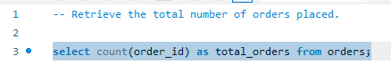
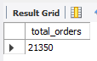
BASIC QUESTIONS
pizza analysis
Retrieve the total number of orders placed.
123 Anywhere St., Any City, ST 12345

Slide 7
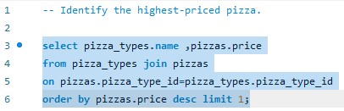
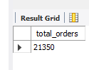
pizza analysis
BASIC QUESTIONS
Identify the highest-priced pizza.
123 Anywhere St., Any City, ST 12345

Slide 8
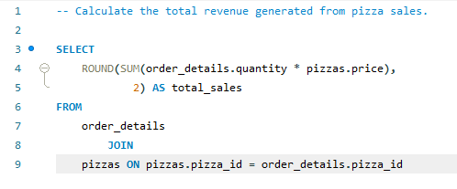
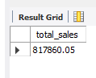
pizza analysis
BASIC QUESTIONS
Calculate the total revenue generated from pizza sales...
123 Anywhere St., Any City, ST 12345

Slide 9
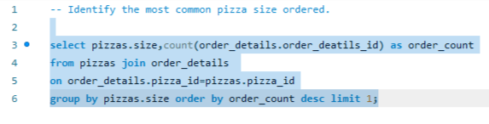
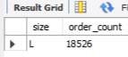
BASIC QUESTIONS
pizza analysis
Identify the most common pizza size ordered.
123 Anywhere St., Any City, ST 12345

Slide 10
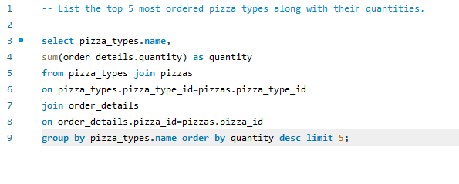
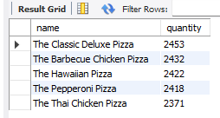
BASIC QUESTIONS
pizza analysis
List the top 5 most ordered pizza types along with their quantities.
123 Anywhere St., Any City, ST 12345

Slide 11
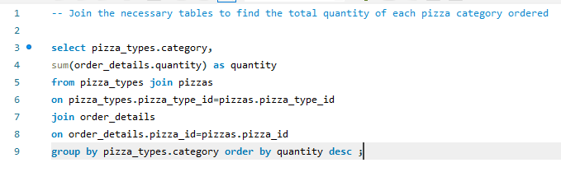
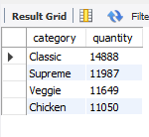
pizza analysis
intermediate questions
JOIN THE NECESSARY TABLES TO FIND THE TOTAL QUANTITY OF EACH PIZZA CATEGORY ORDERED

Slide 12
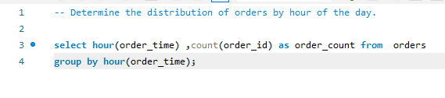
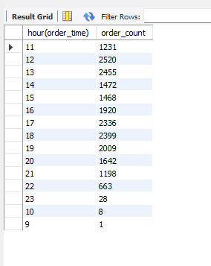
pizza analysis
intermediate questions
DETERMINE THE DISTRIBUTION OF ORDERS BY HOUR OF THE DAY

Slide 13
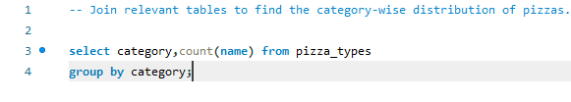
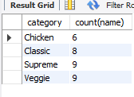
pizza analysis
intermediate questions
JOIN RELEVANT TABLES TO FIND THE CATEGORY-WISE DISTRIBUTION OF PIZZAS.

Slide 14
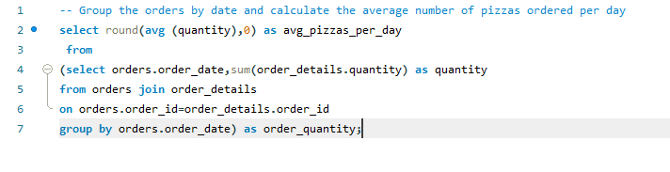
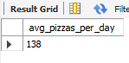
pizza analysis
intermediate questions
GROUP THE ORDERS BY DATE AND CALCULATE THE AVERAGE NUMBER OF PIZZAS ORDERED PER DAY.

Slide 15
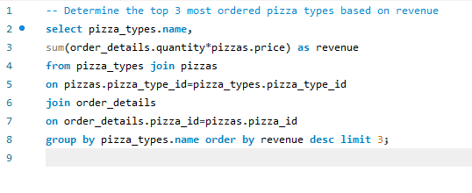
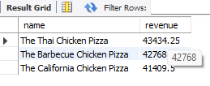
pizza analysis
intermediate questions
DETERMINE THE TOP 3 MOST ORDERED PIZZA TYPES BASED ON REVENUE.

Slide 16
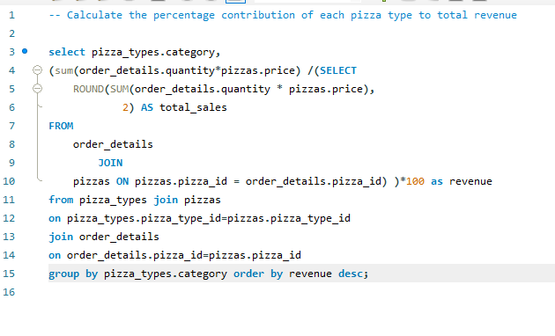
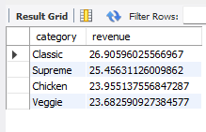
pizza analysis
advanced questions
Calculate the percentage contribution of each pizza type to total revenue.

Slide 17
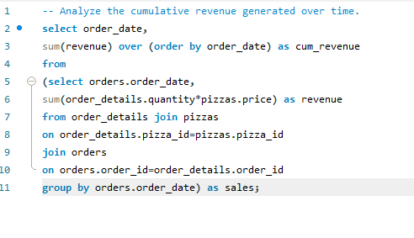
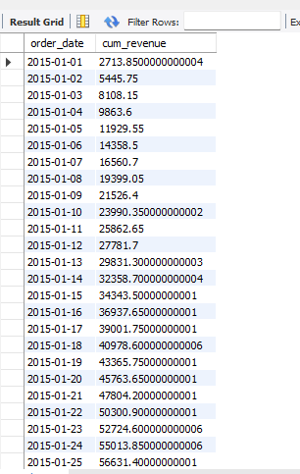
pizza analysis
advanced questions
Analyze the cumulative revenue generated over time.

Slide 18
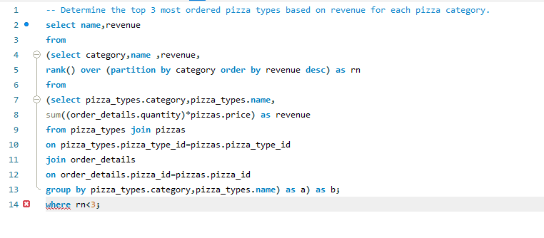
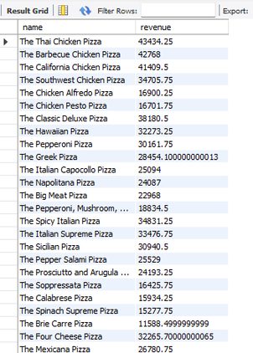
advanced questions
pizza analysis
Determine the top 3 most ordered pizza types based on revenue for each pizza category.

Slide 19
pizza analysis
thank you!

